Slide 1
The Hebrew verb system in xfst
For the course “Finite-State Morphology”
by Ohad Stossel

Slide 2
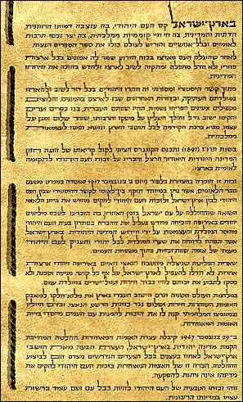
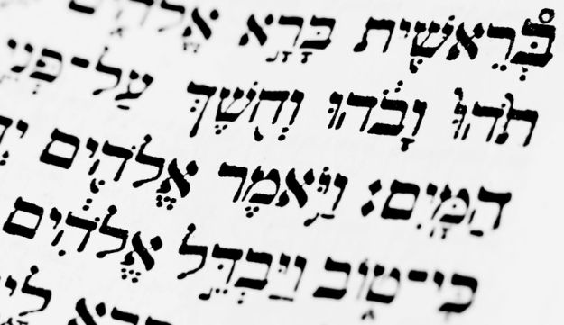

About Hebrew

Slide 3
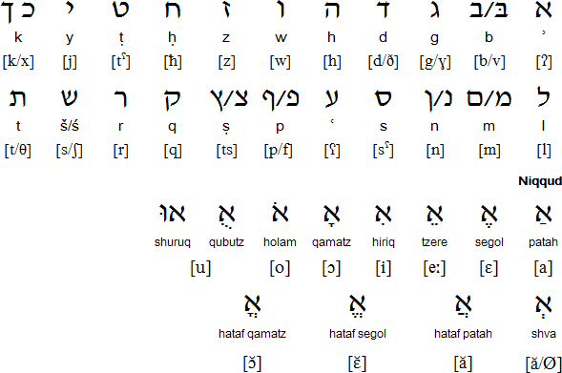
The Hebrew writing system
v
x
A
[t]
[x]
[d]
[g]
j
c
E
[t]
[k]
[s]
Vowels: a, e, i, o, u
Notes:
Even before encountering the language, I had to create a writing system. The Hebrew writing system contains 22 letters and erects 3 problems:
1. It is impossible to read it for those who haven’t learned the letters. 2. the letters are not in ASCII. 3. There is no clear vowel system.

Slide 4
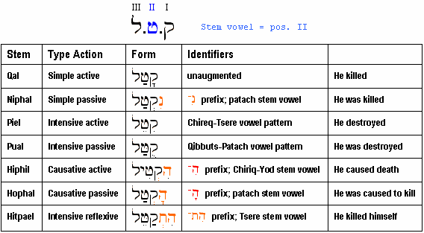
The Hebrew verb system

Slide 5
l
b
j
a
a
hi
i
hit
a
e

Slide 6
l
b
j
a
a
hi
i
hit
a
e

Slide 7
a
a
hi
l
b
i
j
hit
a
e

Slide 8
a
a
hi
i
hit
l
a
b
e
j

Slide 9
a
a

Slide 10
Fut | Pres | Past | Masc.
eXXaX | XoXeX | XaXaXti | 1P
tiXXaX | XoXeX | XaXaXta | 2P
yiXXaX | XoXeX | XaXaX | 3P
a
e
o
Fut | Pres | Past | Fem.
eXXaX | XoXeXet | XaXaXti | 1P
tiXXaXi | XoXeXet | XaXaXt | 2P
tiXXaX | XoXeXet | XaXXa | 3P
Fut | Pres | Past | Plural.Masc
niXXaX | XoXeXim | XaXaXnu | 1P
tiXXaXu | XoXeXim | XaXaXtem | 2P
yiXXaXu | XoXeXim | XaXXu | 3P
Fut | Pres | Past | Plural. Fem.
niXXaX | XoXeXot | XaXaXnu | 1P
tiXXaXu | XoXeXot | XaXaXten | 2P
tiXXaXna | XoXeXot | XaXXu | 3P
Notes:
The verb form works accordingly to gender, tense, person, and number, with many similarities: 1st person is not affected by gender, present tense is not affected by tense

Slide 11
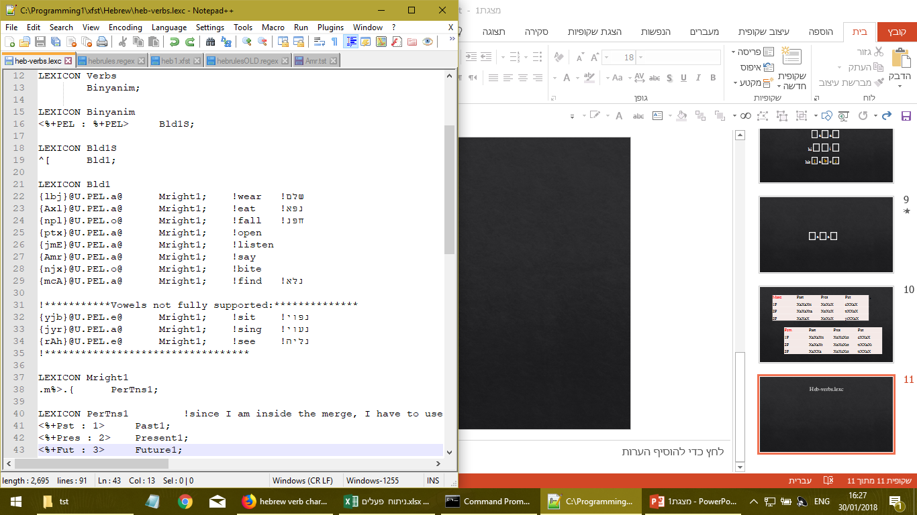
Heb-verbs.lexc
Notes:
The system is supposed to be expendable, so I leave space for more Binyanim to be added. The +PEL is added on both sides to ensure that the rule file could see it and work within the boundaries of the Binyan. Every category matches the Binyan by number

Slide 12
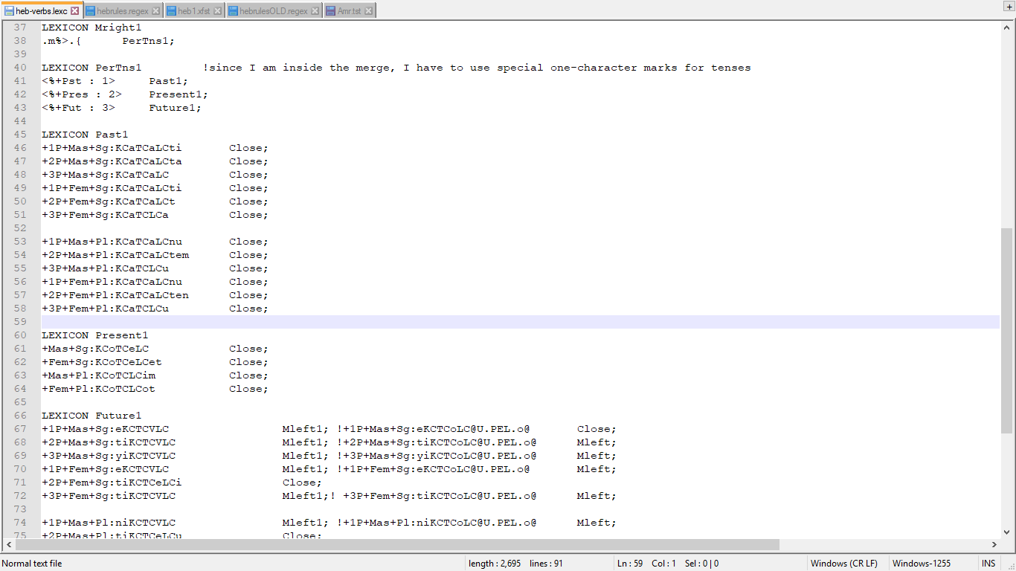
Heb-verbs.lexc
Notes:
The flags are added so the second vowel of the future tense could match the rules of the specific root.
The number represents the tense on the lower side (I could have not use more than one character due to technical complexities)

Slide 13
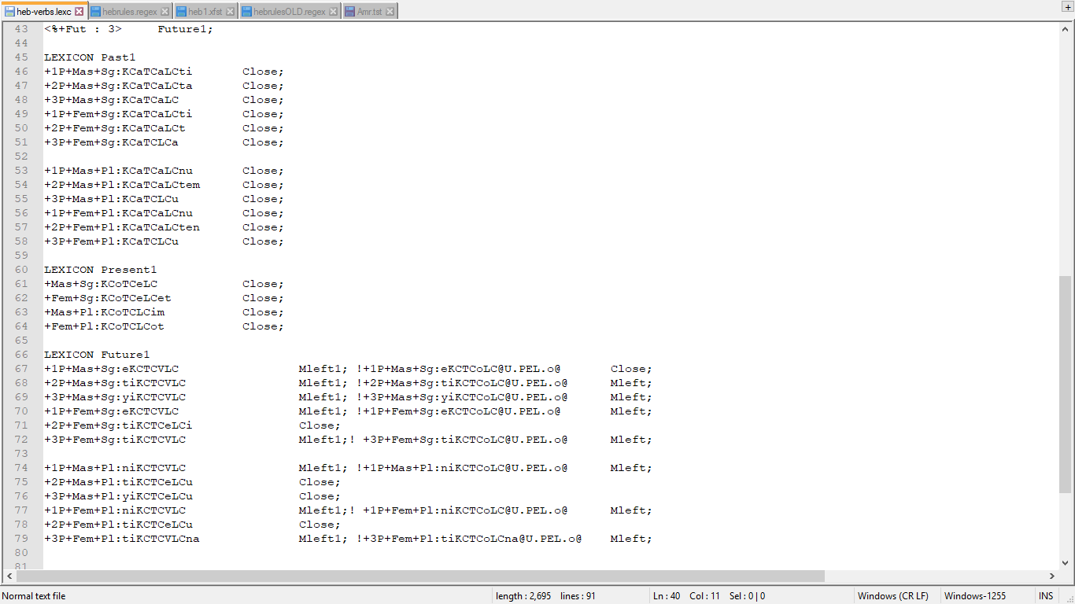
Heb-verbs.lexc
Notes:
All the rest of the tags are added together. Although some of them repeat themselves, this method was the most efficient.
All letters of the root are marked in the word. This allows the rule file to see the inner structure of the word rather to work blindly

Slide 14
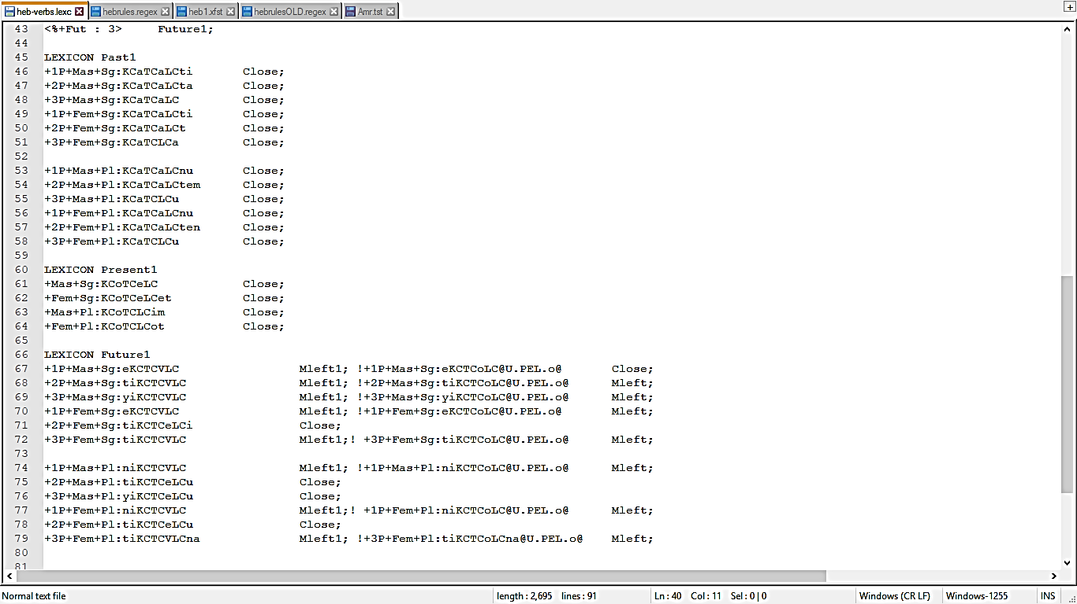
Heb-verbs.lexc
Notes:
All the rest of the tags are added together. Although some of them repeat themselves, this method was the most efficient.
All letters of the root are marked in the word. This allows the rule file to see the inner structure of the word rather to work blindly

Slide 15
Heb-verbs.lexc
Notes:
The future tense features much complexities, and is the most sensitive to irregularities. most of them are taken care in the rule file according to the letters present, but the second vowel is rather random

Slide 16
Heb-verbs.lexc
e
l
b
a
j
ti
l
b
a
j
e
j
m
o
r
ti
j
m
o
r
Notes:
The future tense features much complexities, and is the most sensitive to irregularities. most of them are taken care in the rule file according to the letters present, but the second vowel is rather random

Slide 17
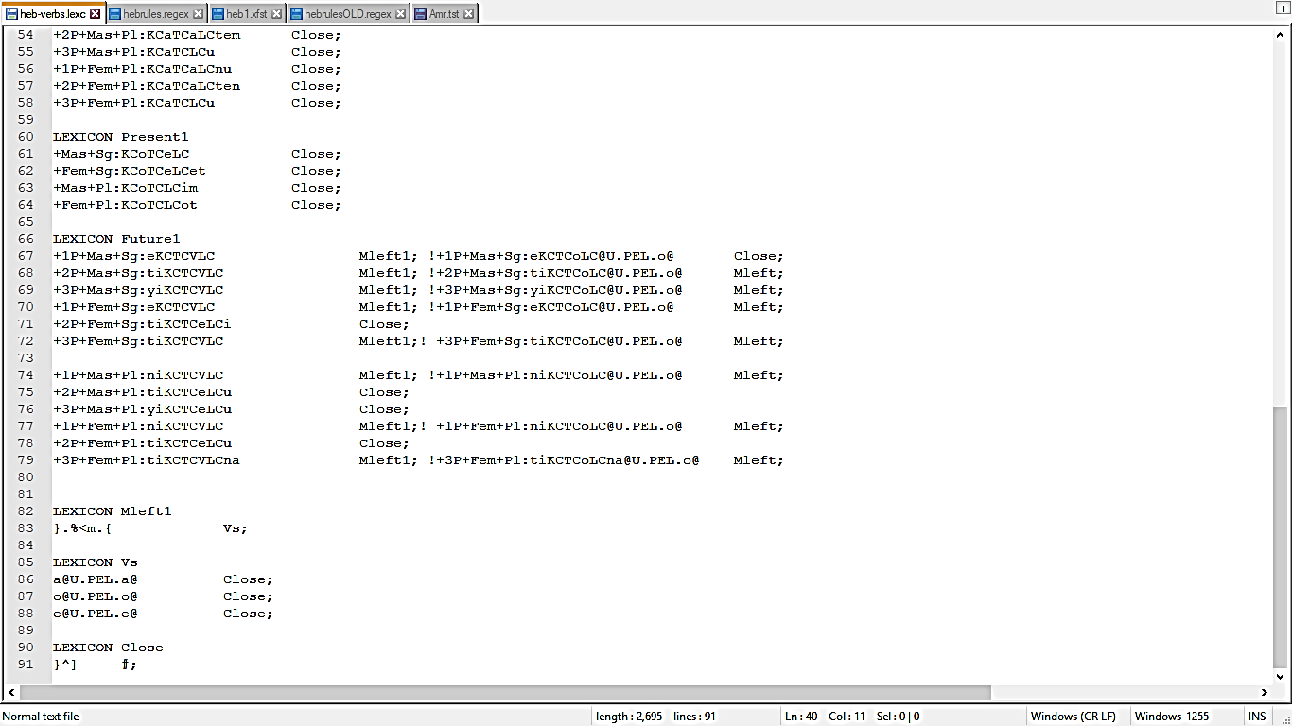
Heb-verbs.lexc
Notes:
These specific future tense verbs have their verbs assigned according to their flags. All the others go directly to close.

Slide 18

Heb-verbs.lexc – the important stuff

Slide 19
Special irregular root types
XFN: {npl} (fall), {njx} (bite)
NFA: {Axl} (eat), {Amr} (say)
NLI/A: {rAh} (see), {tlh} (hang)
Notes:
Hebrew has groups of roots that alter the words around them, usually roots that contain a letter which is harder to pronounce in certain enviroments

Slide 20
XFN:
e
l
b
a
j
ti
l
b
a
j
e
n
p
o
l
ti
n
p
o
l

Slide 21
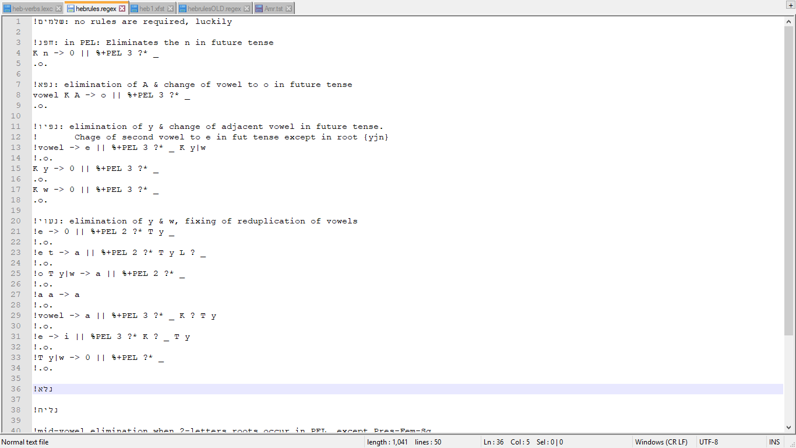
XFN:
e
l
b
a
j
ti
l
b
a
j
e
p
o
l
ti
p
o
l
e

Slide 22
e
l
b
a
j
ti
l
b
a
j
NPA:
e
A
x
a
l
o
to
x
l
ti
A
a
e

Slide 23
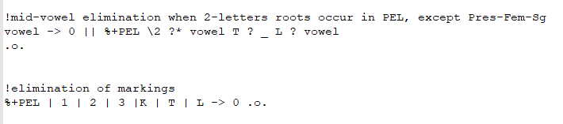
Hebrules.regex
yi
n
p
e
l
u

Slide 24
Hebrules.regex
yi
p
e
l
u

Slide 25
Hebrules.regex
yi
p
l
u

Slide 26
Thank you
Toda raba!
תודה רבה!

